Slide 1
Google Play Store Analysis Using PySpark and Tableau
Data Science project

Slide 2
Project Overview / Business Understanding
A startup company wants to break into the Android mobile app market and understand trends in app success on the Google Play Store.
The project analyzes app ratings, installs, pricing, engagement, and category performance using PySpark and Tableau.
The presentation should flow logically from problem understanding to conclusions.

Slide 3
Dataset and Tools Used
TOOLS USED:
PySpark
Pandas (minimal usage where needed)
Tableau
Jupyter Notebook
CRISP-DM methodology
Dataset loading from:
google_play_store_dataset.csv

Slide 4
Data Understanding (EDA)
Checked schema
Checked null values
Checked duplicate rows
Inspected distinct values
Explored distributions
Reviewed category distributions
Analyzed ratings and installs relationships

Slide 5
Data Cleaning Process
Data Cleaning:
Removed duplicates
Cleaned Installs column by removing commas and plus signs
Cleaned Price column by removing dollar signs
Converted Rating, Reviews, Price, Installs, and Size into numeric types
Handled “Varies with device” values in Size column
Converted KB values to MB
Used safe casting with try_cast
Removed invalid/null records from key analytical fields
Created cleaned dataset:
Google_play_store_cleaned.csv

Slide 6
Tableau Visualizations
Apps by Category
Average Rating by Category
Total Installs by Category
Free vs Paid Apps
Price vs Installs
Ratings vs Installs
Reviews vs Installs
Size vs Rating

Slide 7
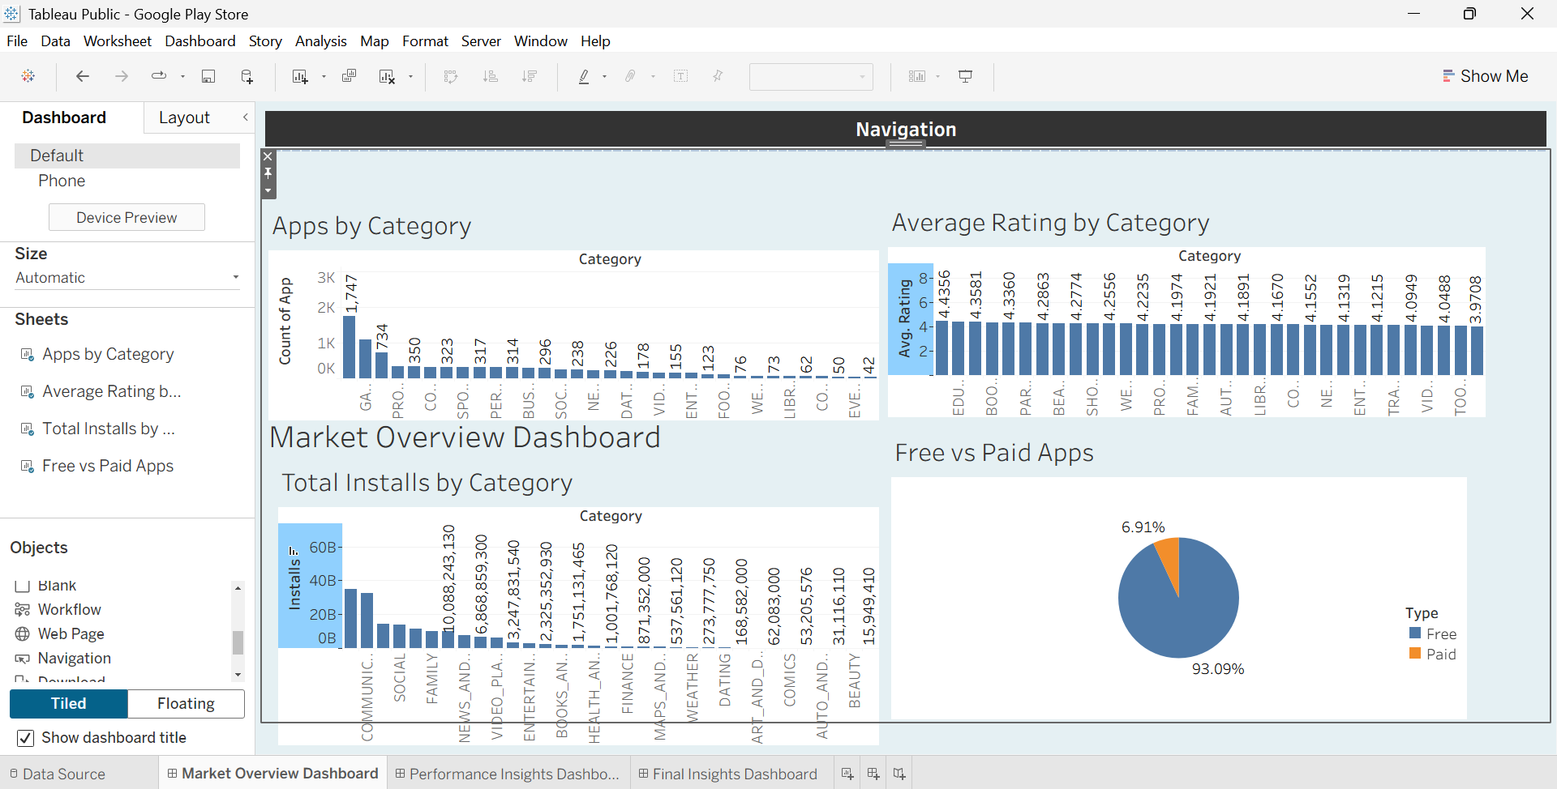
Dashboard 1 Overview
Dashboard 1:
Market Overview Dashboard

Slide 8
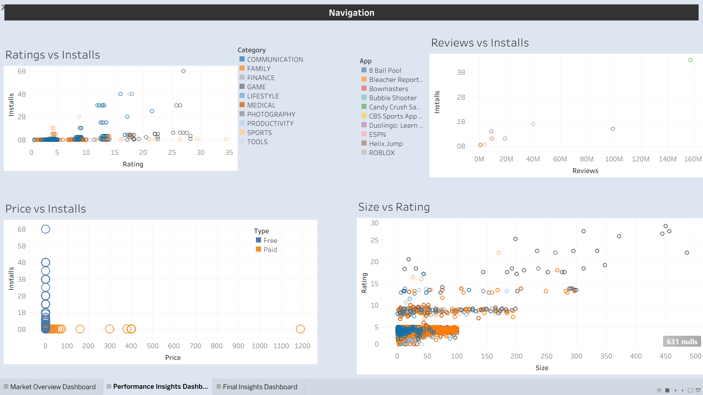
Dashboard 2 Overview
Dashboard 2:
Performance Insights Dashboard

Slide 9
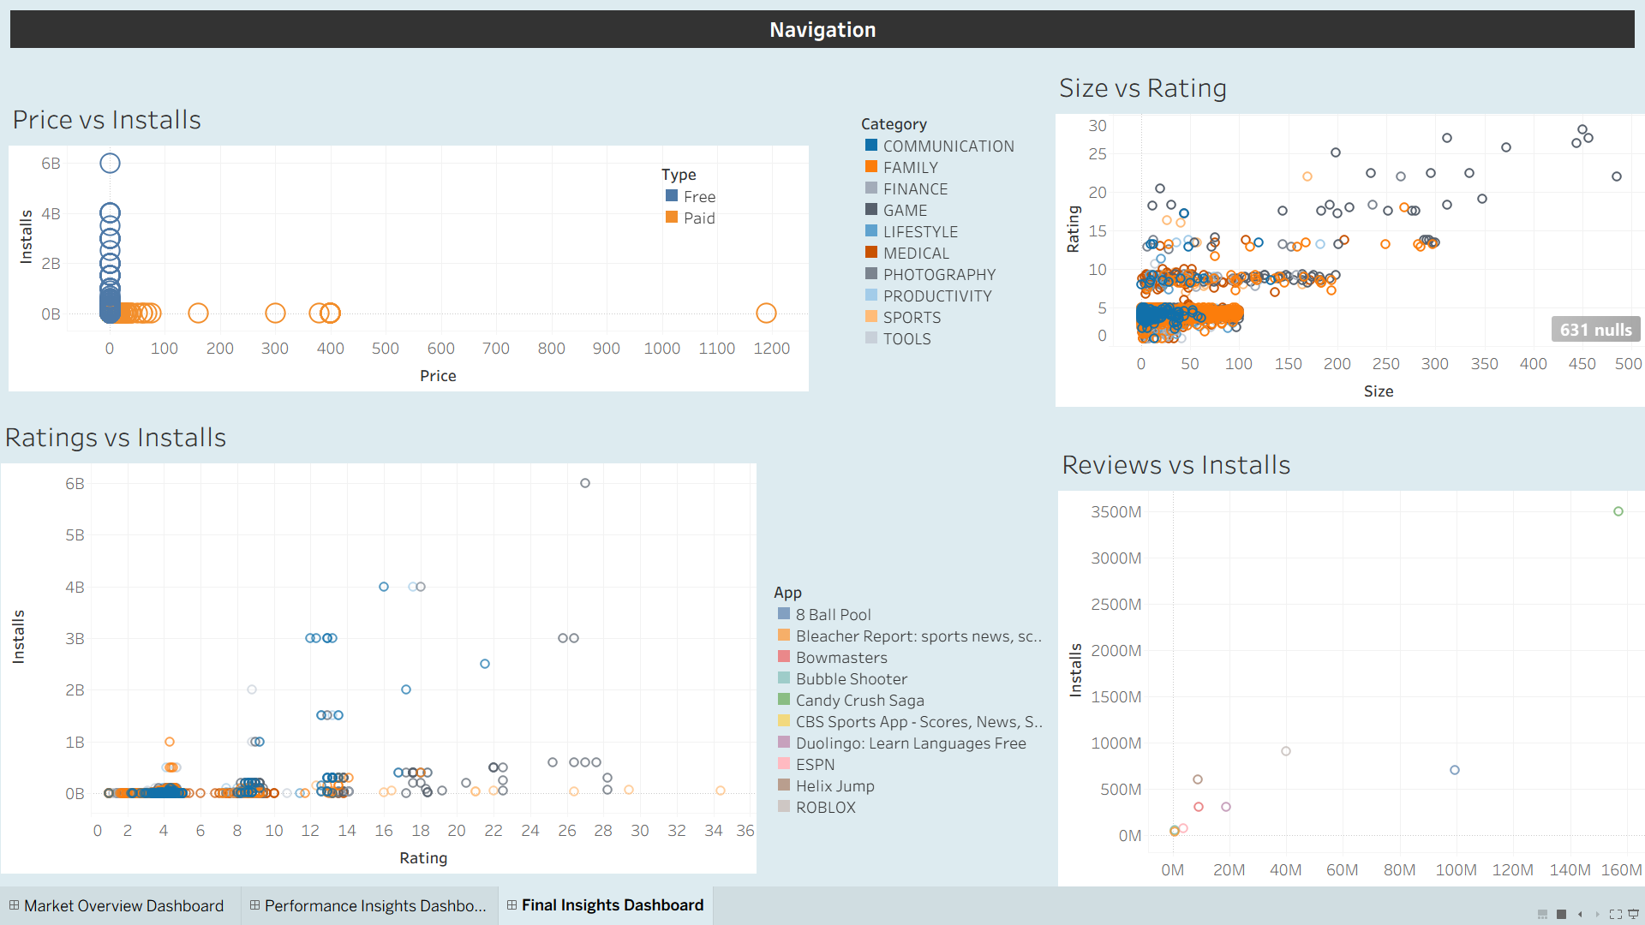
Dashboard 3:
Final Insights Dashboard

Slide 10
Key Findings
Most apps are free
Reviews strongly correlate with installs
Price negatively affects installs
Ratings do not always guarantee popularity
Certain categories dominate installs and engagement

